Slide 1
HEART DISEASE IDENTIFICATION METHOD USING MACHINE LEARNING CLASSIFICATION IN E-HEALTHCARE
Under the Guidance:
Mrs.V.Sujatha ,MCA.,(Ph.D.),Asso.Prof.,
Department of Computer Applications
Presented By
Santhosh S (111921MC02044)

Slide 2
ABSTRACT
Cardiovascular disease prediction aids practitioners in making more accurate health decisions for their patients. Early detection can aid people in making lifestyle changes and, if necessary, ensuring effective medical care.
Machine learning (ML) is a plausible option for reducing and understanding heart symptoms of disease. The chi-square statistical test is performed to select specific attributes from the Cleveland heart disease (HD) dataset.
Support vector machine (SVM), logistic regression, XG Boost, and random forest algorithm have been employed for developing heart disease risk prediction model and obtained the accuracy as 81.97%, 85.25%, 78.69%, and 90.16%, respectively.
The data visualization has been generated to illustrate the relationship between the features. According to the findings of the experiments, the Random Forest algorithm achieves 90.16% accuracy during validation for 303 data instances with 13 selected features of the Cleveland HD dataset.

Slide 3
EXISTING SYSTEM
Expert choice system in light of AI classifiers and the use of fake fluffy rationale is successfully finding the HD therefore, the proportion of death diminishes and The Cleveland heart illness informational index was utilized by different analysts also for the distinguishing proof issue of HD.
The machine learning prescient models need appropriate information for preparing and testing.
The presentation of AI model can be expanded whenever adjusted dataset is use for preparing and testing of the model.
Moreover, the model prescient abilities can improve by utilizing appropriate and related highlights from the information.
Hence, information adjusting and highlight determination is altogether significant for model execution improvement.
In writing different analysis strategies have been proposed by different analysts, anyway these strategies are most certainly not successfully analysis HD.

Slide 4
DIS-ADVANTAGES
Lack of prediction accuracy
High computation time for prediction of HD
There are no successfully hybrid algorithms

Slide 5
PROPOSED SYSTEM
In this system, an AI based conclusion technique for the ID of HD in this examination work. Machine learning prescient models incorporate LR, SVM, XGBoost and Random Forest are utilized for the recognizable proof of HD.
We additionally proposed fast conditional mutual information highlights choice calculation for highlights determination. Leave-one-subject-out cross-validation procedure has been applied to choose the best hyper-boundaries for best model choice.
Aside from this, diverse presentation appraisal measurements have been utilized for classifiers exhibitions assessment. The proposed strategy has been tried on Cleveland HD dataset.
As input to the different ML algorithms such as Random Forest, SVM, Logistic Regression and Xgboost classification techniques.
The input dataset is split into 80% of the training dataset and the remaining 20% into the test dataset. Training dataset is the dataset which is used to train a model. Testing dataset is used to check the performance of the trained model. For each of the algorithms the performance is computed and analysed based on different metrics used such as accuracy, in Random Forest Algorithm.

Slide 6
ADVANTAGES
High accuracy on diagnosis of HD.
In this effectively predict if the patient suffers from heart disease.
Reducing computation time.

Slide 7
SYSTEM CONFIGURATION
H/W SYSTEM CONFIGURATION:
Processor - i3,i5,i7
RAM - 4 Gb
Hard Disk - 500 GB

Slide 8
S/W SYSTEM CONFIGURATION
Operating System - Windows 8/9/10
Front End - Html/ Css
Scripts - Python
Tool - Jupiter(Anaconda)/Python IDLE

Slide 9
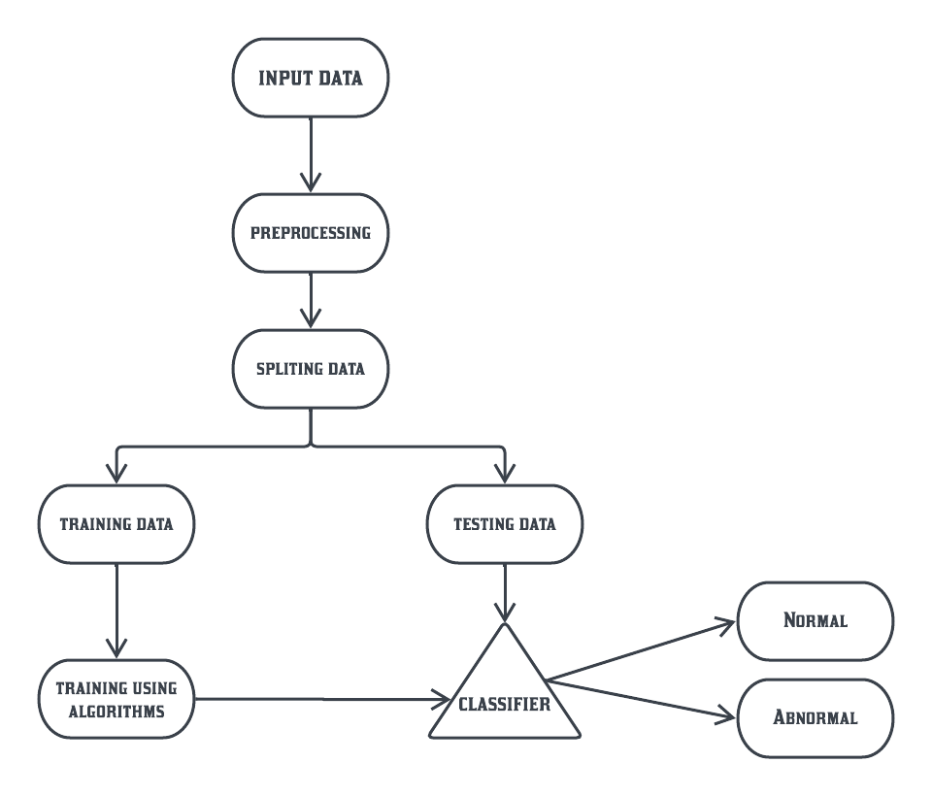
BLOCK DIAGRAM

Slide 10
MODULES
Data pre-processing
Feature selection and reduction
Classification model
Discussion of HRFLM to improve the results

Slide 11
DATA PRE-PROCESSING
Heart disease data is pre-processed after collection of various records. The dataset contains a total of patient records, where records are with some missing values. Those records have been removed from the dataset and the remaining patient records are used in pre-processing. The multiclass variable and binary classification are introduced for the attributes of the given dataset. The multi-class variable is used to check the presence or absence of heart disease. In the instance of the patient having heart disease, the value is set to else the value is set to indicating the absence of heart disease in the patient. The pre-processing of data is carried out by converting medical records into diagnosis values. The results of data pre-processing for patient records indicate that records show the value of establishing the presence of heart disease while the remaining reflected the value of 0 indicating the absence of heart disease.

Slide 12
FEATURE SELECTION AND REDUCTION
From among the attributes of the data set, two attributes pertaining to age and sex are used to identify the personal information of the patient. The remaining attributes are considered important as they contain vital clinical records. Clinical records are vital to diagnosis and learning the severity of heart disease. As previously mentioned in this experiment, Random Forest Algorithm used for prediction. The experiment was repeated with all the ML techniques using all 13 attribute.

Slide 13
CLASSIFICATION MODEL
The clustering of datasets is done on the basis of the variables and criteria of Random Forest (RF) features. Then, the classifiers are applied to each clustered dataset in order to estimate its performance. The best performing models are identified from the above results based on their low rate of error. The performance is further optimized by choosing the RF cluster with a high rate of error and extraction of its corresponding classifier features. The performance of the classifier is evaluated for error optimization on this data set.

Slide 14
DISCUSSION OF HRFLM TO IMPROVE THE RESULTS
The UCI dataset is further classified into 8 types of datasets based on classification rules. The classification rules, each dataset is further classified and processed by R Studio Rattle. The results are generated by applying the classification rule for the dataset. The classification rules generated based on the rule after data pre-processing is done. After pre-processing, the data’s three best ML techniques are chosen and the results are generated. The various datasets with RF, LR are applied to find out the best classification method. The results show that RF and LR are the best. The RF error rate for dataset 4 is high compared to the other datasets. The LM method for the dataset is the best compared to LR and RF methods. We propose convolutional neural network method to improve the results of the proposed method

Slide 15
CODING
from flask import Flask, render_template, request
import pickle
import numpy as np
filename = 'heart.pkl'
model = pickle.load(open(filename, 'rb'))
app = Flask(__name__)
@app.route('/')
def home():
return render_template('main.html')
@app.route('/predict', methods=['GET','POST'])
def predict():
if request.method == 'POST':
age = int(request.form['age'])
sex = request.form.get('sex')
cp = request.form.get('cp')
trestbps = int(request.form['trestbps'])
chol = int(request.form['chol'])
fbs = request.form.get('fbs')
restecg = int(request.form['restecg'])
thalach = int(request.form['thalach'])
exang = request.form.get('exang')
oldpeak = float(request.form['oldpeak'])
slope = request.form.get('slope')
ca = int(request.form['ca'])
thal = request.form.get('thal')
data = np.array([[age,sex,cp,trestbps,chol,fbs,restecg,thalach,exang,oldpeak,slope,ca,thal]])
my_prediction = model.predict(data)
return render_template('result.html', prediction=my_prediction)
if __name__ == '__main__':
app.run(debug=True)

Slide 16
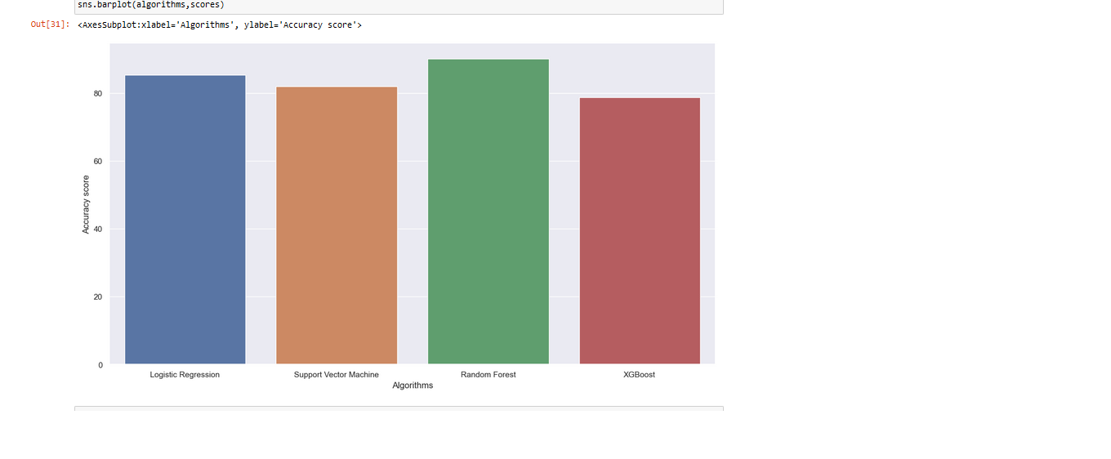
SCREENSHOTS

Slide 17
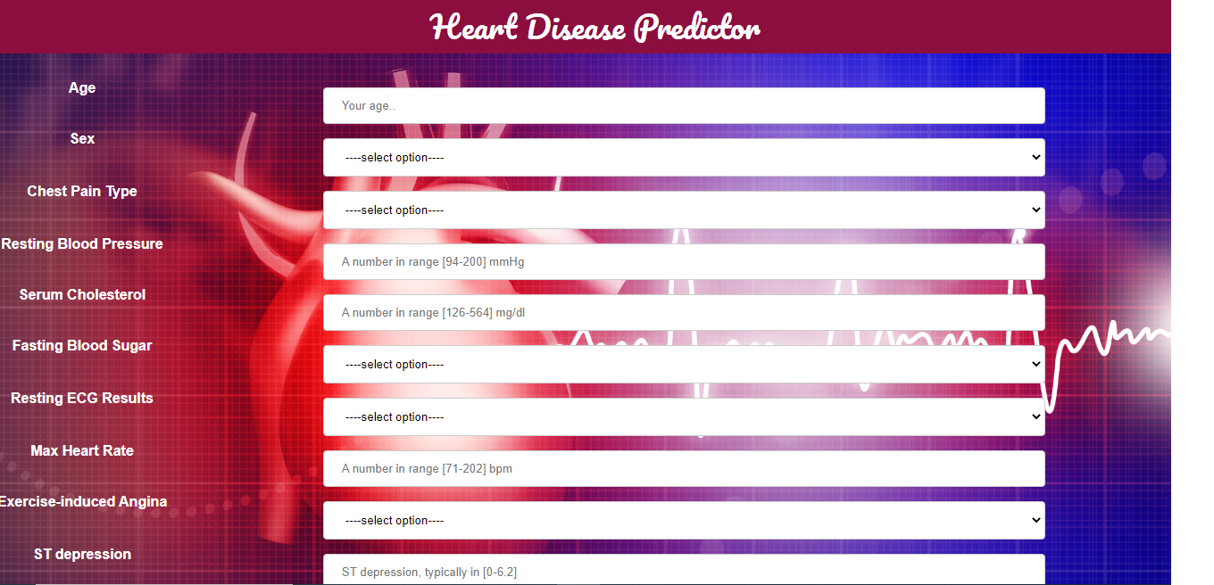
SCREENSHOTS

Slide 18

SCREENSHOTS

Slide 19

SCREENSHOTS

Slide 20
CONCLUSION
In this project, a proficient AI based conclusion framework has been produced for the analysis of heart infection. AI classifiers incorporate LR, XGBoost, SVM and Random Forest are utilized in the planning of the framework. With the increasing number of deaths due to heart diseases, it has become mandatory to develop a system to predict heart diseases effectively and accurately. Cross-approval strategy is utilized in the framework for the best hyper parameters determination. The framework is tried on Cleveland heart illness dataset.

Slide 21
FUTURE ENHANCEMENT
Later on, we will utilize different highlights determination calculations, improvement strategies to additional expansion the exhibition of a prescient framework for HD conclusion accurately.

